Slide 1
QuesNet: A Unified Representation for Heterogeneous Test Questions
ADVISOR:JIA-LING KOH
SOURCE:KDD 19
SPEAKER:LI-WEI LiU
DATA:2020/07/16

Slide 2
OUTLINE
Introduction
Method
Experiment
Conclusion

Slide 3
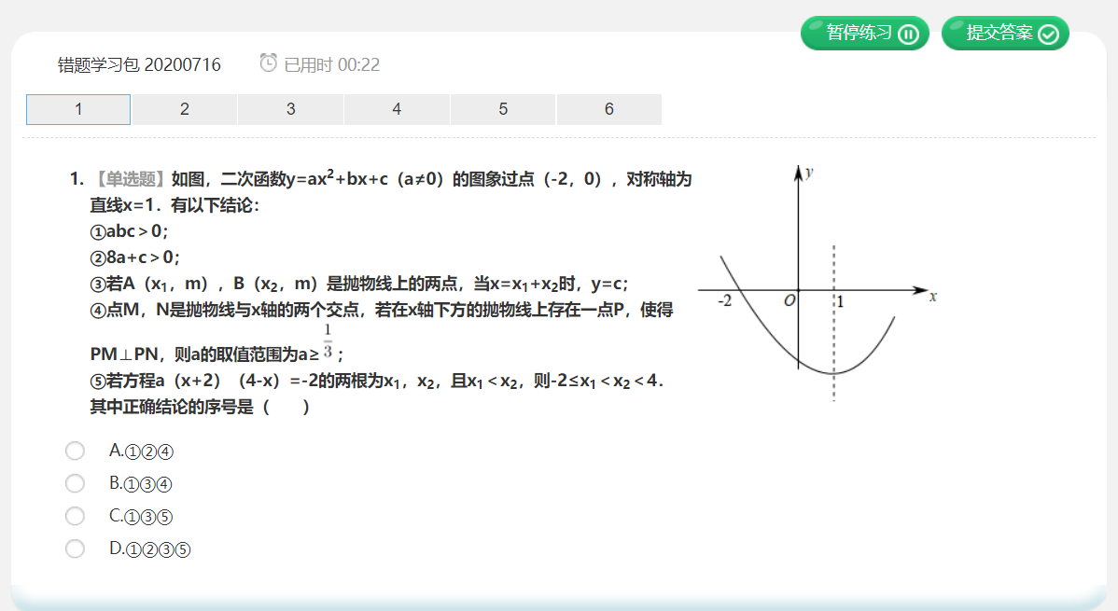
INTRODUCTION
Online Education Question:
Difficulty estimation
Knowledge mapping
Score prediction
Related applications
http://www.zhixue.com
Notes:
難度預估
知識映射
分數預測

Slide 4
INTRODUCTION
A crucial problem:
How to understanding/learning materials?
Dilemma for supervised learning :
Scarce label
Large corpus unused
QuesNet
A pre-train method
Goal↓
Solve the above dilemma
Notes:
關鍵問題：如何理解/學習資料
稀缺標籤
仍然有大量語料庫未使用

Slide 5
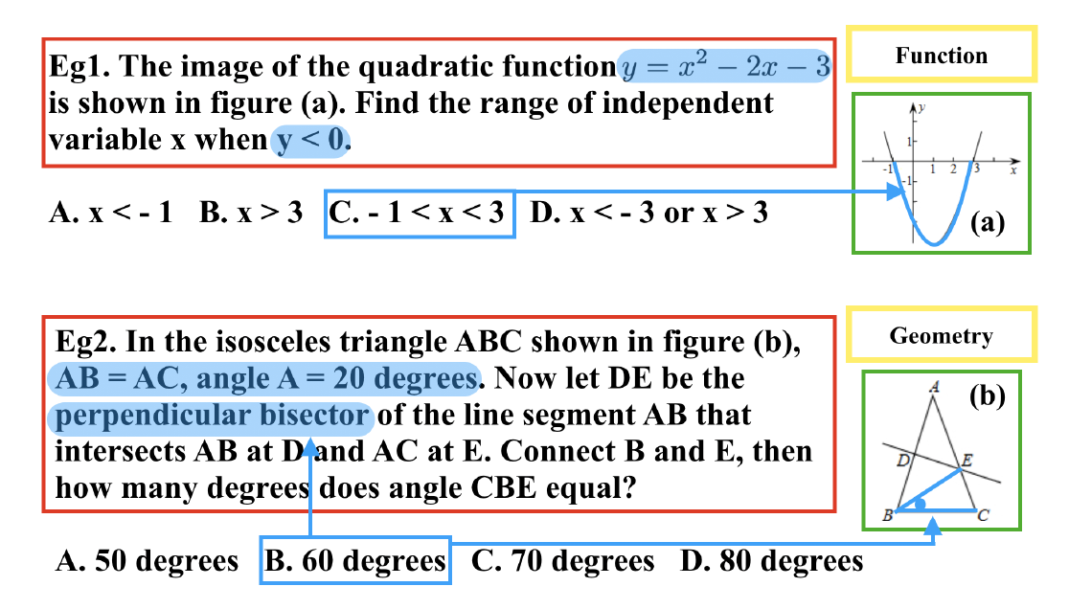
INTRODUCTION
Characteristics of QuesNet
For heterogeneous question:
Turn heterogeneous problems into a unified representation.
Unsupervised way:
Taking large-scale unlabeled question corpus.
Multi-level:
Low-level for linguistic information and high-level for domain logic knowledge.
A question include: text, image and side information such as knowledge concept.

Slide 6
OUTLINE
Introduction
Method
Experiment
Conclusion

Slide 7
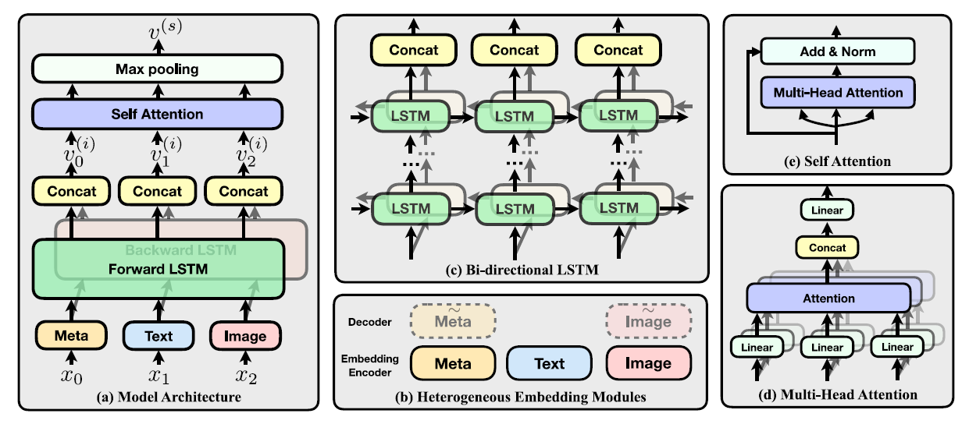
QuesNet model architecture

Slide 8
METHOD Problem Definition
Define question q as a sequence x={x₀, x₁, . . . , x_{T} },
x₀=m (one-hot encoded vector m ∈ R^{K},where K
is the number of categories in side information)
Our goal is to represent q as a sequence of content representation vectors
v^{(i)} = {v₀ ^{(i)} , . . . ,v_{T} ^{(i)} }
Dimension N_{e}

Slide 9
METHOD Embedding Layer
Embedding of Text,image,and
meta data(side information)
Have unified vector size: N_{e}
Text : Word2Vec → to size N_{e}
image : CNN → max-pooling to size N_{e}
meta data: two-layer fully connected neural networks → to size N_{e}

Slide 10
METHOD Content Layer
With L Bi-LSTM layers (L=4)
and concate forward and backward hidden states
Input:
h→ ⁽⁰⁾ =←h ⁽⁰⁾ = {e⁰, e¹, . . . , e^{T} }.

Slide 11
METHOD Sentence Layer
We use self-attention to aggregate content vectors
v^{(i)} together with position embedding pe^{(i)}, by setting
Q,K, V in Multi-Head Attention all as
v₊ ^{(i)} = concatenate(v^{(i)},pe^{(i)})
max pooling
A unified representation of a question
Notes:
Position embedding: feed-forward network 2層線性轉換+ReLU
LayerNorm:通過固定每一層中 ‘計算該層的平均输入值和輸入的平方差’ 來減少“協變量偏移”問題。

Slide 12
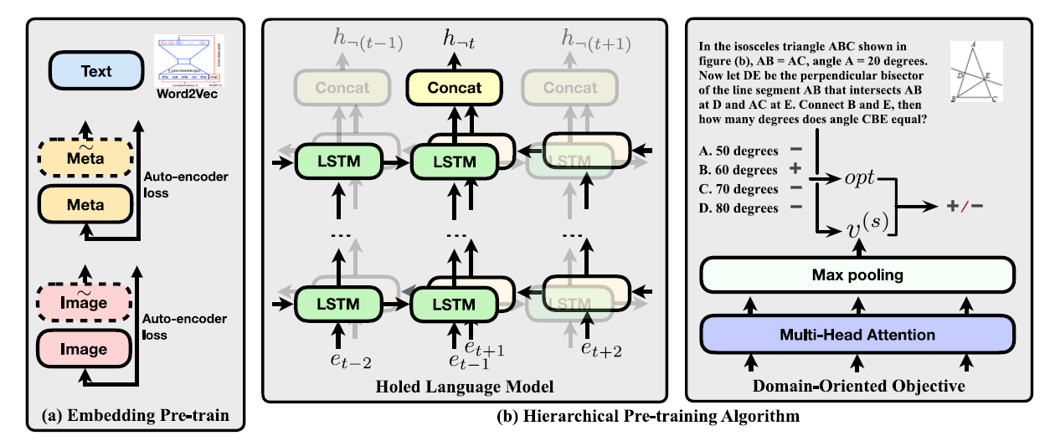
Pre-training of QuesNet

Slide 13
METHOD Embedding Pre-train
Text:
Word2Vec (Use whole corpus)
Image & side information:
Auto-encoder losses (MSE)
y
Initial weight of embedding module
All image information&
All side information

Slide 14
METHOD Holed Language Model (HLM)
Maximize conditioned probability at each position,
for an input sequence x, the objective of HLM calculates:
The goal is to minimize L_{HLM}
(sum of negativelog likelihood)

Slide 15
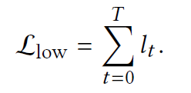
METHOD Holed Language Model (HLM)
x_{t} → h_{t} & x_{￢t} → h_{￢t}
Due to heterogeneous input of a test question
L_{HLM} → L_{low}

Slide 16
METHOD Domain-Oriented Objective
We use its answer and options
Encode the option with a typical text encoder
Get the answer representation as
v_{opt} = enc(opt )
Then we model the probability of the option being the correct answer as:
v_{q} ^{(s)} : Sentence representation for q generated by QuesNet.
D : A fully-connected neural network with output of 1 dimension.

Slide 17
METHOD Domain-Oriented Objective & Fine-tuning
The domain-oriented objective in the high level for question q is
Hierarchical pre-training objective:
Fine-tuning:
QuesNet representation is easy to apply to different downstream tasks and do fine-tuning

Slide 18
OUTLINE
Introduction
Method
Experiment
Conclusion

Slide 19
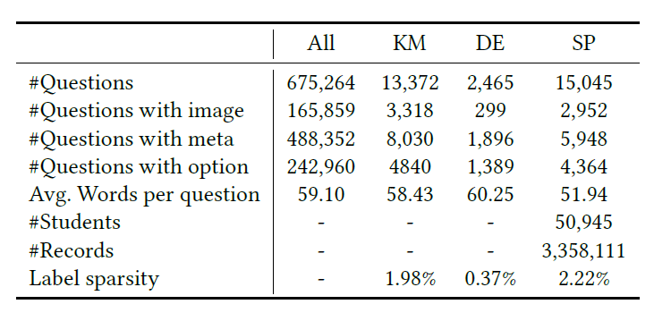
EXPERIMENT DataSets
About 25% of questions contain image content, and about 72% of questions contain side information.

Slide 20
EXPERIMENT QuesNet Setup
1. The embedding modules all output vectors of size : 128 (N_{e}).
2. Image : 4 layer CNN
The size of feature maps at each layer is 16, 32, 32, 64
3. Side information :
two-layer fully connected neural networks
4. The size of the hidden layer : 256
5. Use L = 4 layer of bi-LSTM and 1 layer of self-attention
6. Dropout layers : dropout probability as 0.2

Slide 21
EXPERIMENT Comparison Methods
Notes:
DOA:為了計算一致程度，我們考慮每一對電影，其中一個電影（例如，M1）位於該人的測試集中（該電影實際上已被該人觀看），而另一部電影（例如，M2）為不在該人的測試集中或訓練集中（該人尚未觀看電影）。如果在根據訓練集計算的排名列表中，電影M1在電影M2之前，則評分算法會以正確的順序對這對電影進行排名。因此，個體的一致程度是按正確順序排列的線對相對於線對總數的百分比[60]。這裡的想法是，計分算法應通過將確實觀看過的電影排在未觀看的電影之前，對電影進行評分。
Original : supervised learning / KM [31] ,DS [13] ,SP [27]
ELMo/BERT 只使用text representation
H-BERT :跟QN不一樣應該在 它只使用label data
1.支持異構輸入的模型比沒有的好->可以看出理解問題時處理異構輸入至關重要
2.基於Transformer的方法比基於LSTM的ELMo差->因為label data稀少 導致BERT的masked language model pretraining strategy 效果會比較差

Slide 22
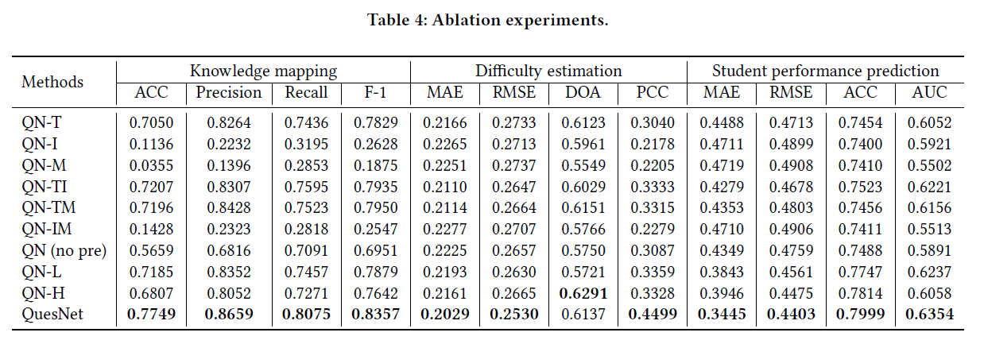
EXPERIMENT Comparison Methods

Slide 23
OUTLINE
Introduction
Method
Experiment
Conclusion

Slide 24
CONCLUSION
We designed a heterogeneous modeling architecture to represent heterogeneous input as a unified form.
We proposed a novel hierarchical pre-training framework
Holed language model (HLM) for pre-training low-level linguistic features.
A domainoriented objective for learning high-level domain logic and knowledge.
We hope this work builds a solid basis for question related tasks in the area of education, and help boost more applications in this field.
Notes:
我們設計了一個允許異構輸入的模型結構，將異構輸入表示為統一形式。
我們提出了一種新穎的分層預訓練框架
孔式語言模型（HLM），用於預訓練底層語言功能。
一個面向領域的目標，用於學習高級領域邏輯和知識。
我們希望這項工作可以為教育領域中與問題相關的任務打下堅實的基礎，並有助於推動該領域的更多應用。

